Slide 1
BT201
Biochemical Process Calculations:
Multiphase system
13/10/2022

Slide 2
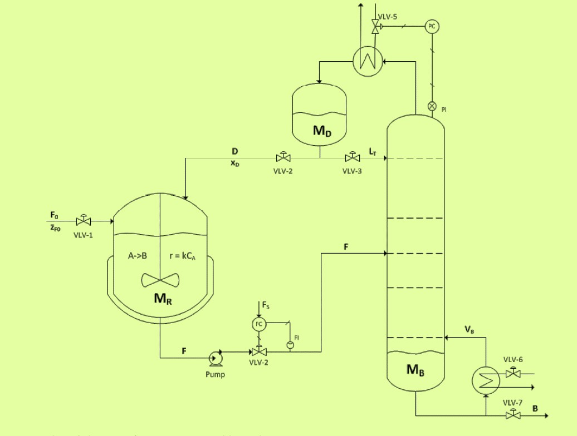
Multiphase in chemical/biochemical processes
Some process units in chemical/ biochemical industry accomplish physical separations, (do not involve reactions) in which components of mixture are separated into two or more fractions.
Top product
multiphase: (Vapor-liquid)
As a rule, separation/purification processes involve multiple phases are easy to perform. It is difficult to separate different components of a single phase.
Physical process
Reactor/Bioreactor
(reaction)
Bottom product
Involves: Liquid / gas / solid / immiscible / partially immiscible liquid

Slide 3
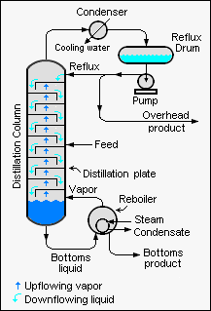
Multiphase system example: distillation
Distillation (vapor-liquid contact )
Separating high volatile component
--component from low volatile component
separation based on relative volatility
Alcohol (99%)
+ water
Example:
Product (ethanol, butanol) recovery from water (fermentation/distillery)
Refinery (get different fuels from crude petroleum)
Petrochemical (get ethylene oxide from ethylene oxide +water, get propylene from propylene +propane)
Water + alcohol
Water + Alcohol (1%)

Slide 4
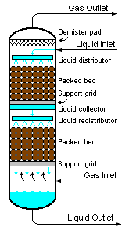
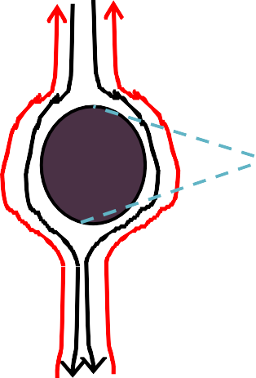

MULTIPHASE SYSTEM EXAMPLE: ABSORPTION:
Gas
(air + low CO₂/SO₂)
Liquid
(Water+ less or
no CO₂/SO₂)
+low solute
Absorption: mass transfer operation in which one or more species (solute) is removed from a gaseous stream by dissolution in a liquid
mass transfer: solute transfer from gas to liquid
+low solut
+high
solute
Liquid
(Water+ high CO₂/SO₂)
Gas
(air + high CO₂/SO₂
+high solute

Slide 5
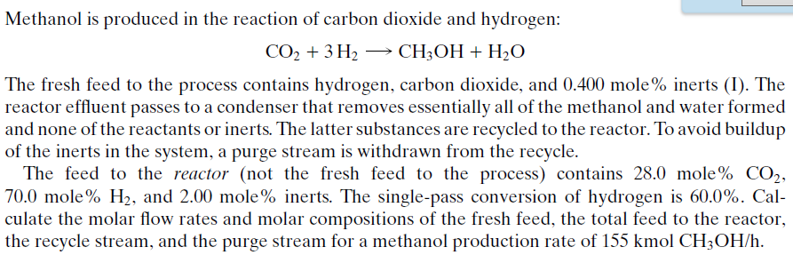
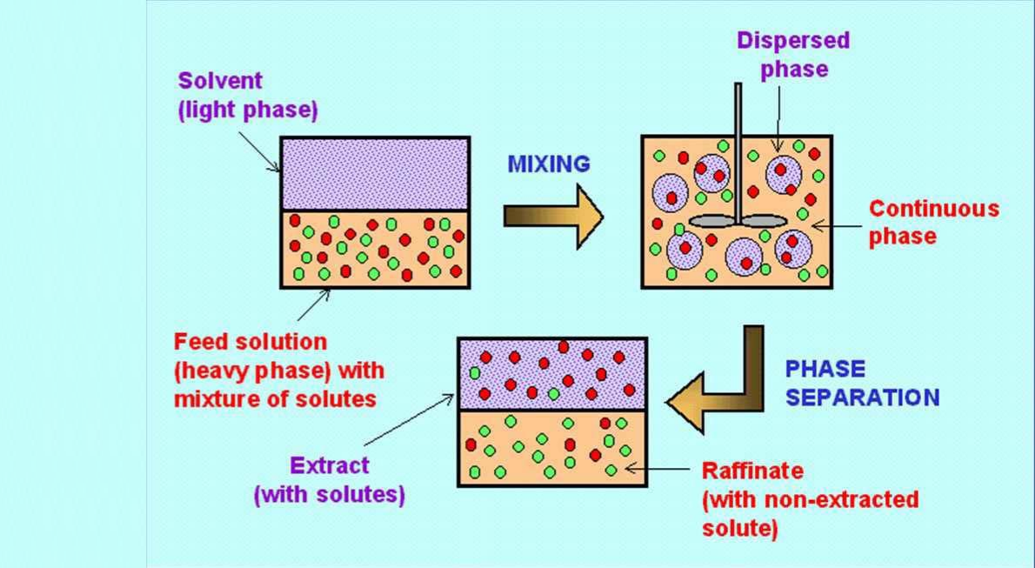
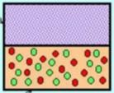


Multiphase system example: Extraction
Liquid-Liquid extraction is a mass transfer operation in which a liquid solution (the feed) is contacted with an immiscible or nearly immiscible liquid (solvent) that exhibits preferential affinity or selectivity towards one or more of the components in the feed.
Example:
To separate closed-boiling point mixture that cannot withstand high temperature of distillation
Example:
Recovery of penicillin from fermentation broth; solvent: butyl acetate.
Perfumes, fragrances and essential oils
Recovery of acetic acid from dilute aqueous solutions; solvent: ethyl-acetate.

Slide 6
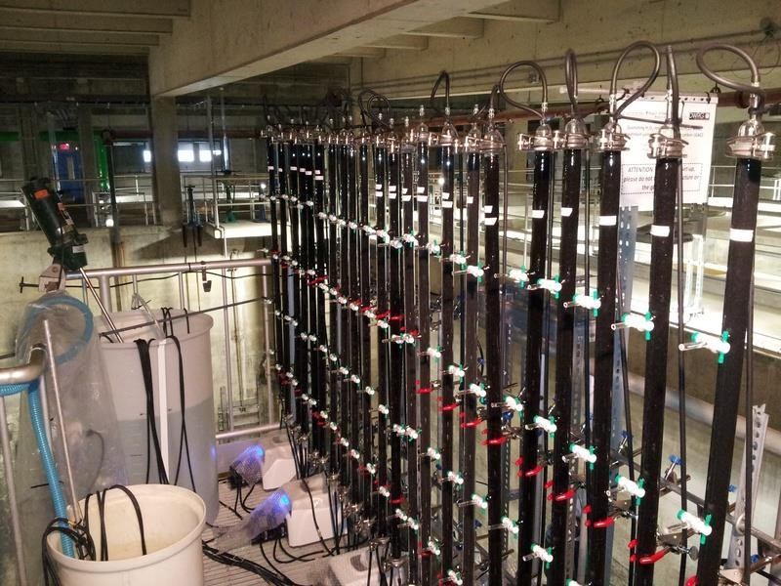
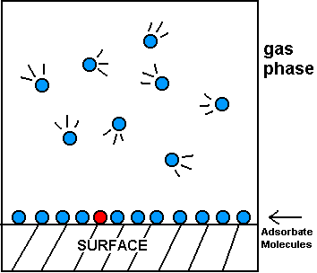


Multiphase system example: Adsorption
Gas or liquid solutes selectively accumulates on the solid surface.
or liquid phase
Solid surface
Waste water treatment

Slide 7
Multiphase
Absorption or scrubbing process: a separation process involving a gas in contact
with a liquid solution. For example, removal of sulfur dioxide from a gas stream.
Gas→liquid
Stripping process: a separation process involving a liquid in contact with a gas. (typically absorption and stripping columns run in parallel for regeneration of liquid solvent used in absorption process)
liquid→gas
Adsorption: A separation process involving attraction of chemical species in gases or liquids to the surface of solids
Gas→Solid Liquid→solid
Distillation: a separation process exploits the difference in vapor pressure by
partially vaporizing a liquid mixture, yielding a vapor relatively rich in some components and a residual liquid relatively rich in other components. For example, recovery of methanol from an aqueous solution.
Vapor→liquid
liquid→Vapour

Slide 8
Cont..
Liquid extraction: separation process exploits the difference in the miscibility of certain components in liquid among different liquid solvent. For example, separation of paraffinic and aromatic hydrocarbons.
liquid→liquid (immiscible/partially)
Leaching: the operation of dissolving a component of a solid phase in a liquid solvent. For example, brewing a cup of coffee
solid→liquid
Crystallization: a separation process exploits the difference in the freezing points of certain components. For example, separation of an isomeric mixture. Solute come out of from solution as solid crystal
solute (from
solution) as solid
vapor (from solid) into the gas
Drying: mass is transferred as a vapor (from solid) into the surrounding gas

Slide 9
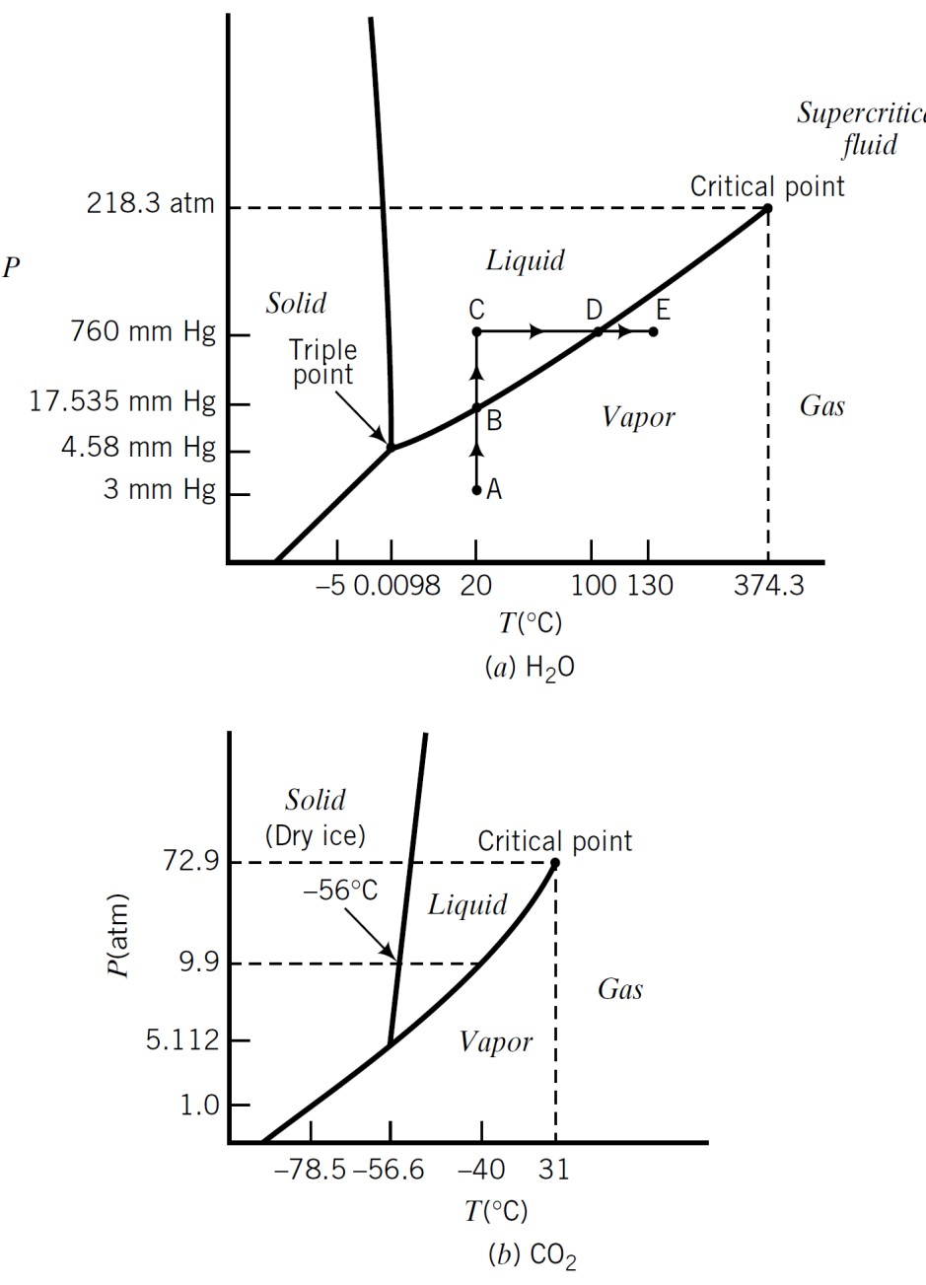
Phase equilibrium and phase diagram
Phase equilibrium: When species transfer from one phase to another, the transfer rate generally decreases with time until the second phase is saturated with the species, holding as much as it can hold at the prevailing process condition. When the concentration of all the species in each phase no longer changes with time, the phase are said to be in phase equilibrium.
phase 1I A, B…..
phase 1 A, B….
A phase diagram of a pure substance is a plot of one system variable against another that shows the conditions at which the substance exists as a solid, a liquid, and a gas. The most common of these diagrams plots pressure on the vertical axis versus temperature on the horizontal axis. The boundaries between the single-phase regions represent the pressures and temperatures at which two phases may coexist.

Slide 10
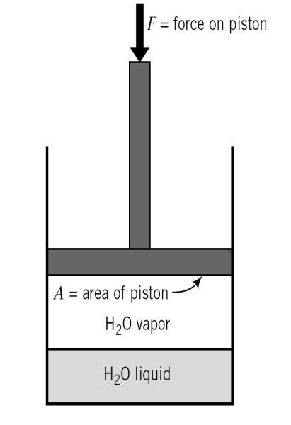
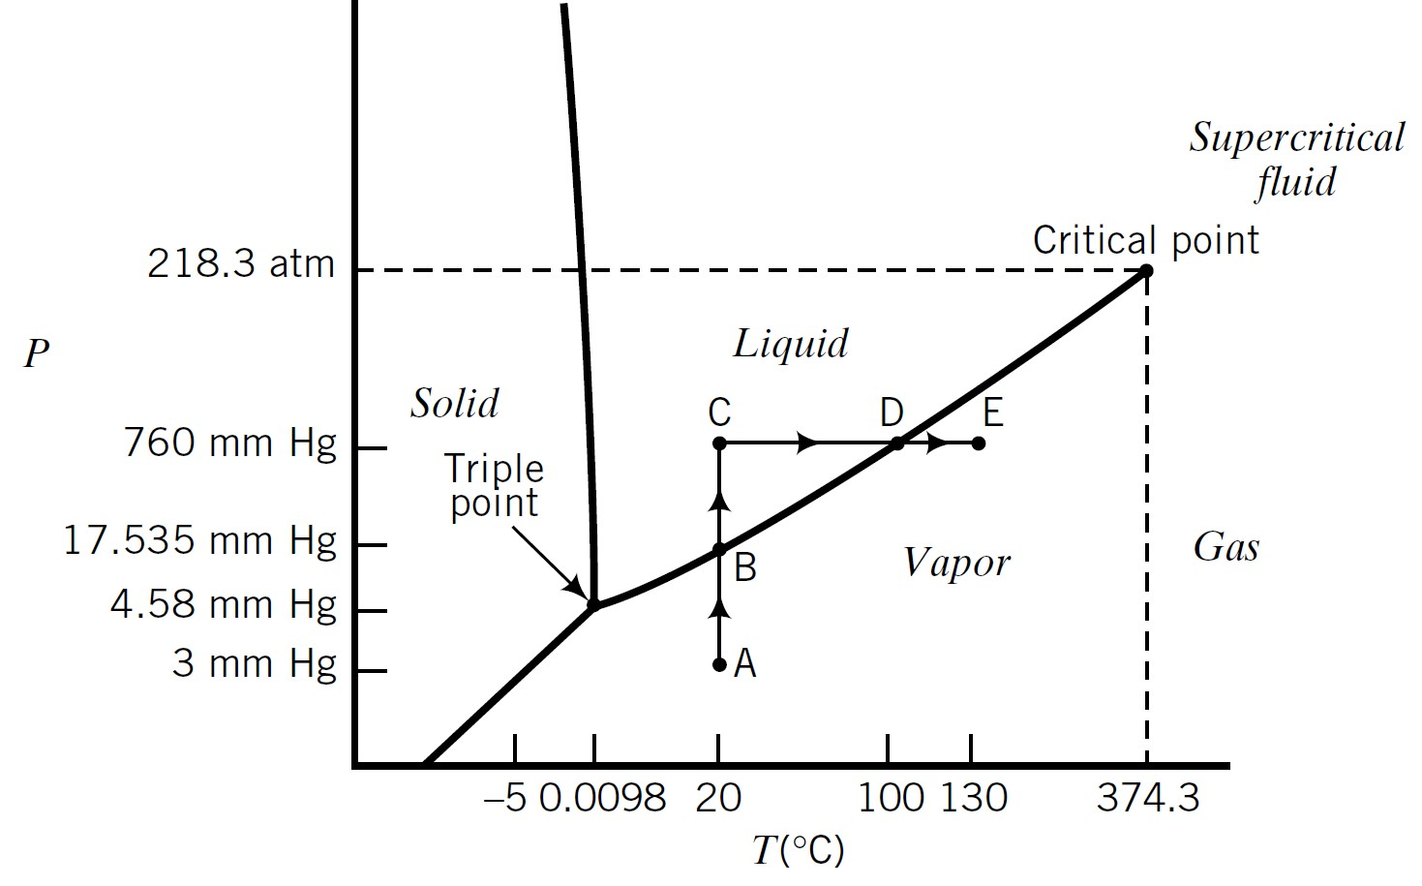
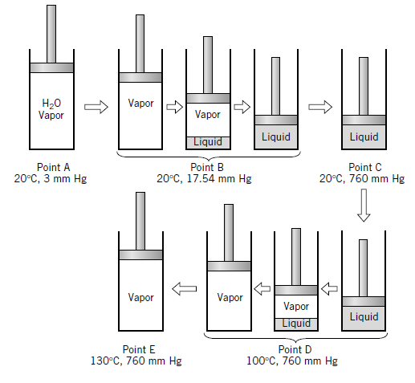
A phase diagram
Single component phase equilibrium
Pure water is placed in a leak proof cylinder fitted with movable piston
Pressure can be adjusted by varying force F
Heat can be added or withdrawn (for adjusting to any desired temperature)
The state of water follows the path A (V) →B (V-L)→ C (L)→ D(L-V)→ E (V)

Slide 11
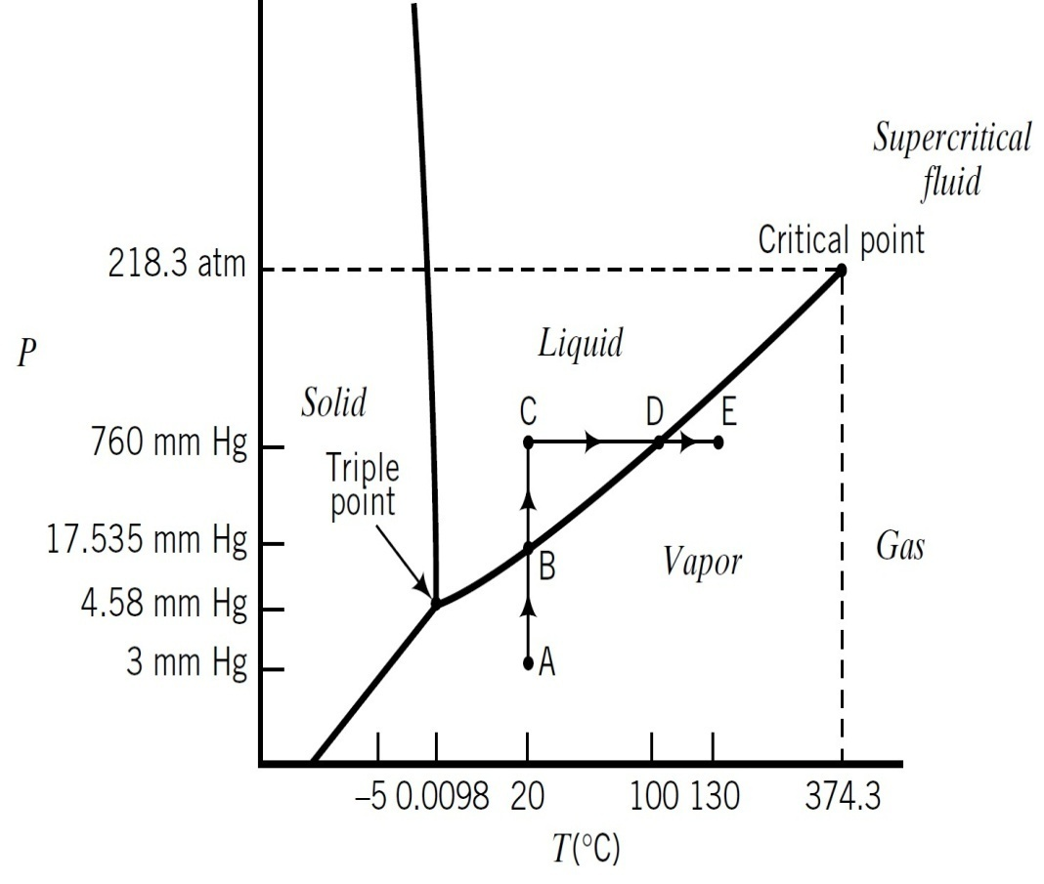
Phase diagram……
Several familiar terms may be defined with reference to the phase diagram.
If ( T, P) falls on the vapor–liquid equilibrium curve, P is the vapor pressure of the substance at temperature T, and T is the boiling point of the substance at pressure P .
-----If P=1 atm, T is called the normal boiling point of that substance.
If ( T, P) falls on the solid–liquid equilibrium curve, then T is the melting point or freezing point at pressure P.
If ( T, P ) falls on the solid–vapor equilibrium curve, then P is the vapor pressure of the solid at
temperature T, and T is the sublimation point at pressure P.
The point ( T, P) at which solid, liquid, and vapor phases can all coexist is called the triple point of the substance.
The vapor–liquid equilibrium curve terminates at the critical temperature and critical pressure and ( T_{C}
and P_{C} ). Above and to the right of the critical point, two separate phases never coexist.

Slide 12
Vapor-Liquid and gas liquid equilibrium calculation for ideal solution
Raoult’s Law: Describe the vapour liquid equilibria of ideal solution
𝒚_{𝑨} : mole fraction of A in gas phase
Vapour A +B+C
^{𝒑}𝑨 ^{= 𝒚}𝑨 ^{𝑷}𝒕𝒐𝒕
= 𝒙_{𝑨} 𝒑∗ (𝑻 )
𝒙_{𝑨} : mole fraction of A in liquid phase
𝑨
Liquid
A+B+C
𝒑 : partial pressure of A in the gas phase
𝑨
𝒑∗ (𝑻 ): vapour pressure of A (depends on T)
𝑨
Raoult’s law is an approximation that is generally valid when x_{A} is close to 1 that is, when the liquid is almost pure A
Henry’ Law
^{𝒑}𝑨 ^{= 𝒚}𝑨 ^{𝑷}𝒕𝒐𝒕
= 𝒙_{𝑨} 𝑯_{𝑨} (𝑻 )
𝑯_{𝑨} (𝑻 ): Henry’ Law constant for A in a specific solvent
Henry’s law is generally valid for solutions in which x_{A} is close to 0 (dilute solutions of A ) provided that does not dissociate, ionize, or react in the liquid phase

Slide 13
Importance of vapor pressure (V-L equilibrium)
Important for liquid-vapor equilibrium
In distillation components are separated based on the relative volatility (top product: high volatility and bottom product: low volatility)
α ( or α
₎ ₌ concentration ratio of A and B in vapour phase
AB
concentration ratio of A and Bin liquid phase
_{p}*
FEED (A,B…)
x
A A
^{P}tot
x
_{p}*
y
B B
_{p}*
A
y_{B}
P_{tot}
vapour pressure of A
=
=
=
A
=
x_{A}
x_{A}
_{p}*
vapour pressure of B
x x
B
B B
(α > 1 good separation)
High vapour pressure→ high volatility
Low vapour pressure→ low volatility
Data: from table
For design need the Vapour pressure data at different temperature
mole fraction of A in vapour: y_{A} or y or y* at equilibrium
Vapour
A+B
T, P_{tot}
Liquid A+B
mole fraction of A in liquid: x_{A} or x

Slide 14
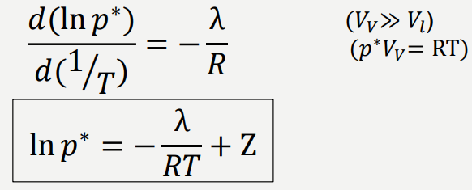
VAPOR PRESSURE: CLAUSIUS-CLAPEYRON EQUATION
(Chemical potential are same in both
vapor and liquid phases)
𝑑𝑝∗ λ
=
𝑑𝑇 𝑇(𝑉_{𝑉} − 𝑉_{𝑙})
𝑉_{𝑉}=molar volume (volume/mole) of vapor
𝑉_{𝑙}=molar volume (volume/mole) of liquid
λ: latent heat of vaporization
𝑝∗: vapor pressure, T: temperature
Z: constant, different for
different substances

Slide 15
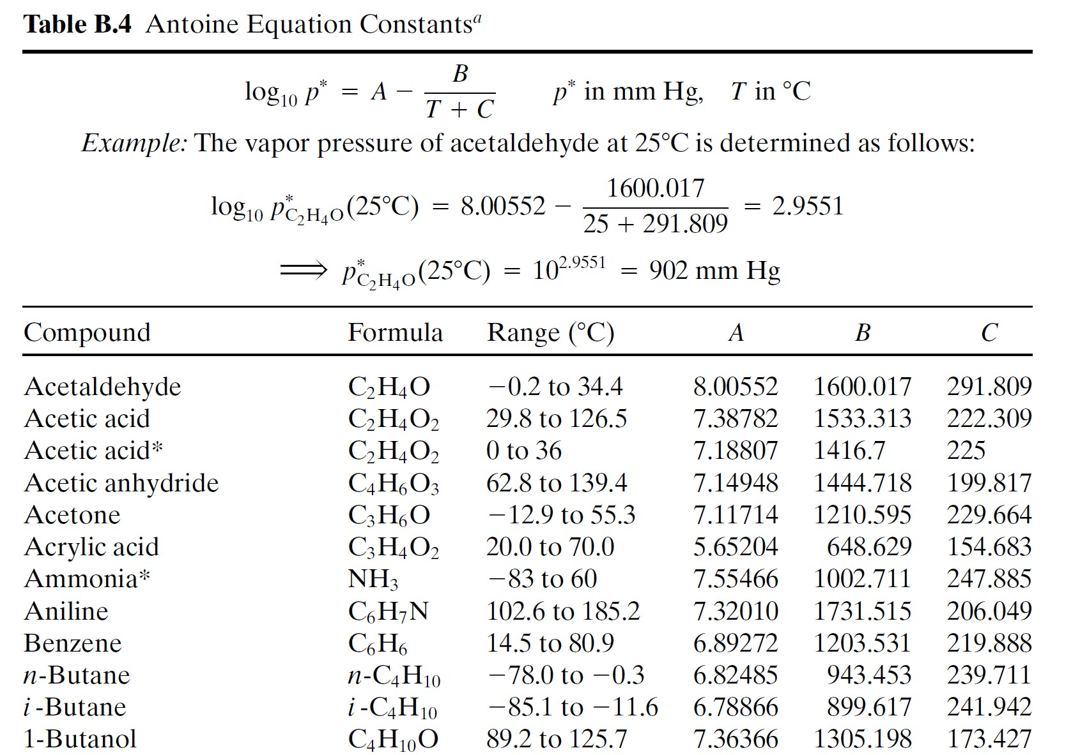
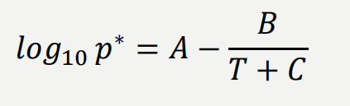
VAPOR PRESSURE: Antoine Equation
Antoine Equation
𝐴, 𝐵 𝑎𝑛𝑑 𝐶: 𝑐𝑜𝑛𝑠𝑡𝑎𝑛𝑡
T: (°C),
𝒑∗: mmHg

Slide 16
Degree of freedom: Gibbs phase rule
Extensive variable: depends on the size of system
Example: mass, volume
Intensive variable: do not depends on the size
Example: temperature, pressure, density, specific volume, mass
and mole fraction of individual system components in each phase
Gibb’s Phase rule: F=C-P+2,
F: Degree of freedom
C: number of component/chemical species P: the number of phases at equilibrium
Vapour A+B
T, P
mole fraction of A in vapour: y_{A} (y) or y*
Degree of freedom (DF) : number of intensive variables that must be specified for a system at equilibrium to calculate the remaining intensive variables
t
Liquid A+B
mole fraction of A
in liquid: x or x
A
C=2 (for binary system, example ethanol (A) and water (B)) P=2 (the vapour and liquid phase)
F=2; So the system has two degree of freedom

Slide 17
Cont..
The total number of parameters and variables: F=C-P+2 = 2-2+2 = 2
(Temperature (T), total Pressure(P_{t}), liquid composition and vapor composition)
As F=2, two quantities need to be fixed to define the system in equilibrium.
Vapour A+B T, P_{t}
mole fraction of A
in vapour: y_{A} (y) or
y*
if T and P are fixed , the liquid and vapour composition will be
t
automatically fixed if the system is in equilibrium.
If T and liquid composition are fixed ,the P_{t} and vapour composition
will be automatically fixed if the system is in equilibrium.
Liquid A+B
mole fraction of A in liquid: x_{A} or x
Pure liquid water:
P=1, C=1, F=1-1+2=2
Two intensive variables must be specified to fix the state of the system, for example, T and
P. Once these two variables have been specified, other intensive variables such as viscosity and density may be determined by nature

Slide 18
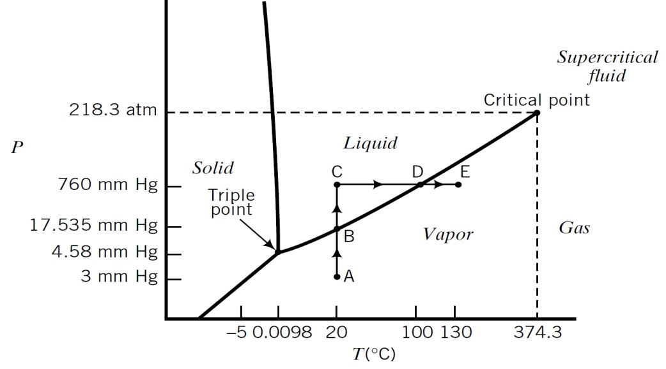
Cont..
A mixture of liquid, solid, and vapor water:
P=3, C=1, DF=2+1-3=0
No further information about the system is required, all intensive variables are fixed.
Three phases coexist at equilibrium at only one temperature and pressure
A vapor-liquid mixture of acetone and methyl ethyl ketone (MEK)
P=2, C=2, DF = 2 + 2 – 2 = 2
Two variables must be specified to fix the state of the system.
Setting T and P: can fixes the acetone and MEK mole fractions in both the vapor and liquid phases
Setting T and acetone mole fraction in vapor phase: P and acetone mole fraction in liquid are then
fixed

